Slide 1


Slide 2

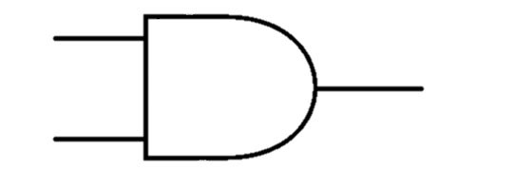
AND Gate
0
0
0
0
1
1
1
1
A | B | Y
1 | 1 | 1
1 | 0 | 0
0 | 1 | 0
0 | 0 | 0
1
0
0
0

Slide 3

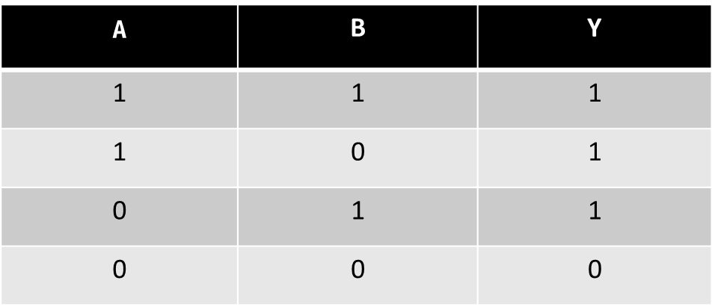
OR Gate
1
0
0
0
1
1
1
0
1
1
1
0

Slide 4

XOR Gate
0
0
1
1
0
1
0
1
A | B | Y
1 | 1 | 0
1 | 0 | 1
0 | 1 | 1
0 | 0 | 0
0
1
1
0

